Slide 1
EMERGING TRENDS OF MEDIATION IN INDIA

Slide 2
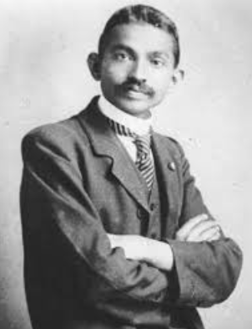
“I realized that the true function of a lawyer was to unite parties given as under. The lesson was so indelibly burnt into me that a large part of my time during the twenty years of my practice as a lawyer was occupied in bringing about private compromise of hundreds of cases. I lost nothing thereby not even money; certainly not my soul.”
- MAHATMA GANDHI

Slide 3
WHAT IS MEDIATION?
A process in which two or more people involved in a dispute come together to try and find a fair and workable solution to their problem.
This process is accomplished through the use of a mediator who is a neutral third person who is trained in cooperative conflict resolution.
Notes:
A process” not “a meeting”
Other Definitions
Mediation is a process in which an impartial third party facilitates communication and negotiation and promotes voluntary decision making by the parties to the dispute.
Problem solving negotiation
Facilitated legal negotiation

Slide 4
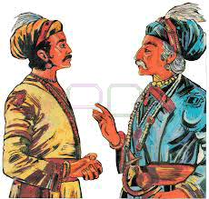
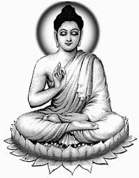
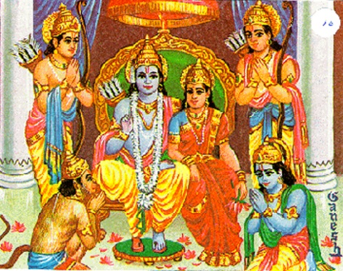
HISTORY OF MEDIATION IN INDIA
Ancient way of resolving disputes as it finds a mention even in the Vedic India.
Notes:
Mulla's Hindu Law, ancient India began its search for laws since Vedic times
approximately 4000 to 1000 years B.C. and it is possible that some of the Vedic hymns were composed
at a period earlier than 4000 B.C. The early Aryans were very vigorous and unsophisticated people
full of joy for life and had behind them ages of civilized existence and thought. THEY PRIMARILY
INVOKED THE UNWRITTEN LAW OF DIVINE WISDOM, REASON AND PRUDENCE, WHICH ACCORDING TO THEM GOVERNED
HEAVEN AND EARTH. This was one of the first originating philosophies of mediation - Wisdom, Reason
and Prudence, which originating philosophy is even now practiced in western countries.
Buddha said, "Meditation brings wisdom; lack of mediation leaves ignorance.
Know well what leads you forward and what holds you back; choose that which leads to wisdom".
Ancient Indian Jurist Patanjali said, "Progress comes swiftly in
mediation for those who try hardest, instead of deciding who was right and who was wrong".
Emperor Akbar depended upon his mediator minister Birbal.

Slide 5
Indian mythology mentions similar steps of resolving the dispute during the times of Mahabharata and Ramayana where Lord Krishna and Lord Hanuman respectively tried to mediate on behalf of the affected party.
Mediation fostered with the rise of Buddhism as Buddha said “better than a thousand hollow words is one word that gives peace”.

Slide 6
POST VEDIC PERIOD
The era of Dharma Shastra's' (Code of Conduct)
The tribunal propounded and set up by a brilliant scholar Yagnavalkya, known as KULA, which dealt with the disputes between members of the family, community, tribes, castes or races.
Another tribunal known as SHRENI, a corporation of artisans following the same business, dealt with their internal disputes.
PUGA was a similar association of traders in any branch of Commerce.
Parashar, A Scholar, opined that certain questions should be determined by the decisions of a parishad or association or an assembly of the learned.
These associations were invested with the power to decide cases based on principles of justice, equity and good conscience.
Notes:
Dharma Shastra's' [code of conduct] followed the Vedic epoch, during which period scholastic jurists developed the philosophy of basic laws. Their learned discourses recognized existing usages and customs of different communities, which included resolution of disputes by non-adversarial indigenous methods.
During the days of Yagnavalkya there was an unprecedented growth and progress of trade, industry and commerce and the Indian merchants are said to have sailed the seven seas, sowing the seeds of International Commerce.

Slide 7
PANCHAYATS AS MEDIATORS
One interesting case often quoted is when two women claimed motherhood of a child, the Mediator suggested cutting the child into two and dividing its body and giving one-half to each woman. The real mother gave up her claim to save the child's life whereas the fake mother agreed to the division. The child was then given to the real mother.
Refer to Judgment of Solomon
Notes:
Though this was not a fully-developed example of modern mediation, it is
an example of interest-based negotiation where the neutral third party seeks to identify the underlying
needs and concerns of the parties.
It is widely accepted that a village panchayat, meaning five wise
men, used to be recognized and accepted as a conciliatory and / or decision- making body. Like many
of the ancient dispute resolution methods, the panchayat shared some of the characteristics of
mediation and some of the characteristics of arbitration.

Slide 8
PRE-BRITISH RULE IN INDIA
The Mahajans were respected, impartial and prudent businessmen who used to resolve the disputes between merchants through mediation.
Notes:
Mediation, Conciliation and Arbitration, in their earlier forms are historically more ancient than the present day Anglo-Saxon adversarial system of law.
Various forms of mediation and arbitration gained a great popularity amongst businessmen during pre-British Rule in India. They were readily available at business centers to mediate the disputes between the members of a business association.
The rule in the constitution of the Association made a provision to dismember a merchant if he resorted to court before referring the case to mediation. This was a unifying business sanction. This informal procedure in vogue in Gujarat, the western
province of India, was a combination of Mediation and Arbitration, now known in the western
world, as Med-Arb.
This type of mediation had no legal sanction in spite of its wide common acceptance
in the business world.

Slide 9
MEDIATION UNDER THE COLONIAL RULE
By 1753 India was converted into a British Colony and the British style courts were established in India by 1775. The British ignored local indigenous adjudication procedures and modeled the process in the courts on that of British law courts of the period.
Notes:
The East India Company from England gained control over the divided Indian
Rulers and developed its apparent commercial motives into political aggression.
However, there was a conflict between British values, which required a clear-cut decision, and Indian values, which encouraged the parties to work out their differences through some form of compromise.

Slide 10
LEGAL RECOGNITION OF MEDIATION IN INDIA
Industrial Disputes Act, 1947
The Legal Services Authorities Act, 1987 (to encourage the settlement of disputes by way of negotiations, arbitration and conciliation.
The Arbitration and Conciliation Act in 1996.
The CPC Amendment Act of 1999 inserting Sec.89 in the Code of Civil Procedure 1908.
Notes:
The concept of mediation received legislative recognition in India for the first time in the Industrial
Disputes Act, 1947. The conciliators appointed under Section 4 of the Act are “charged with the
duty of mediating in and promoting the settlement of Industrial disputes."
Detailed procedures were prescribed for conciliation proceedings under the Act.
Arbitration, as a dispute resolution process was recognized as early
Arbitration, as a dispute resolution process was recognized as early as 1879 and also found a
place in the Civil Procedure Code of 1908. When the Arbitration Act was enacted in 1940 the
provision for arbitration originally contained in Section 89 of the Civil Procedure Code was repealed.
The Indian Legislature made headway by enacting The Legal Services Authorities Act, 1987 by
constituting the National Legal Services Authority as a Central Authority with the Chief Justice of
India as its Patron-in-Chief.
The Indian parliament enacted the Arbitration and Conciliation Act in 1996 , making elaborate provisions for conciliation of disputes arising out of legal relationship, whether contractual or not, and to all proceedings relating thereto. The Act provided for the commencement of conciliation proceedings, appointment of conciliators and assistance of suitable institution for the purpose of recommending the names of the conciliators or even appointment of the conciliators by such institution, submission of statements to the conciliator and the role of conciliator in assisting the parties in negotiating settlement of disputes between the parties.
In 1999, the Indian Parliament passed the CPC Amendment Act of 1999 inserting Sec.89 in the
Code of Civil Procedure 1908, providing for reference of cases pending in the Courts to ADR which
included mediation. The Amendment was brought into force with effect from 1st July, 2002.

Slide 11
DEVELOPMENT AND EVOLUTION OF MEDIATION IN INDIA
Institute for the Study and Development of Legal Systems (ISDLS)
Arbitration
Mediation Legal Education and Development (AMLEAD)
Ahmedabad Mediation Centre
The U.S. Educational Foundation in India (USEFI
The Chennai Mediation Centre
Delhi High Court Mediation and Conciliation Centre.
The Mediation and Conciliation Project Committee (MCPC)
Mediation centre at Karkardooma
Rohini in 2009
Notes:
The first elaborate training for mediators was conducted in Ahmedabad in the year 2000 by American trainers sent by Institute for the Study and Development of Legal Systems (ISDLS). It was followed by a few repeated advance training workshops conducted by Institute for Arbitration
Mediation Legal Education and Development (AMLEAD) a Public Charitable Trust settled by two
senior lawyers of Ahmedabad. On 27th July 2002, the Chief Justice of India, formally inaugurated
the Ahmedabad Mediation Centre, reportedly the first lawyer-managed mediation centre in India.
The Chief Justice of India called a meeting of the Chief Justices of all the High Courts of the Indian
States in November, 2002 at New Delhi to impress upon them the importance of mediation and the
need to implement Sec. 89 of Civil Procedure Code. Institute for Arbitration Mediation Legal
Education and Development (AMLEAD) and the Gujarat Law Society introduced, in January 2003,
a thirty-two hours Certificate Course for "Intensive training in Theory and Practice of Mediation".
The U.S. Educational Foundation in India (USEFI) organized training workshops at Jodhpur, Hyderabad
and Bombay in June 2003. The Chennai Mediation Centre was inaugurated on 9th April, 2005 and it
started functioning in the premises of the Madras High Court. This became the first Court-Annexed
Mediation centre in India. The Delhi Judicial Academy organized a series of mediation training
workshops and opened a mediation centre in the Academy's campus appointing its Deputy Director
as the mediator. Delhi High Court Mediation and Conciliation Centre has been regularly organizing
mediation awareness workshops and Advanced Mediation Training workshops.
The Mediation and Conciliation Project Committee (MCPC) was constituted by the then Chief
Justice of India Hon'ble Mr. Justice R.C. Lahoti by order dt. 9th April, 2005. Hon'ble Mr. Justice N.
Santosh Hegde was its first Chairman. It consisted of other judges of the Supreme Court and High
Court, Senior Advocates and Member Secretary of NALSA. The Committee in its meeting held on
11th July, 2005 decided to initiate a pilot project of judicial mediation in Tis Hazari Courts. The
success of it led to the setting up of a mediation centre at Karkardooma in 2006, and another in
Rohini in 2009. Four regional Conferences were held by the MCPC in 2008 at Bangalore, Ranchi,
Indore and Chandigarh.
The Supreme Court of India upheld the constitutional validity of the new law reforms in the
case filed by Salem Bar Association and appointed a committee chaired by Justice Mr. Jagannadha Rao, the chairman of the Law Commission of India, to suggest and frame rules for ironing out the
creases, if any, in the new law and for implementation of mediation procedures in civil courts. The
Law Commission prepared consultation papers on Mediation and Case Management and framed and
circulated model Rules. The Supreme Court approved the model rules and directed every High Court
to frame them. The Law Commission of India organized an International conference on Case
Management, Conciliation and Mediation at New Delhi on 3rd and 4th May 2003, which was a great
success. Delhi District Courts invited ISDLS to train their Judges as mediators and help in establishing
court annexed mediation centre. Delhi High Court started its own lawyers managed mediation and
conciliation centre. Karnataka High Court also started a court-annexed mediation and conciliation
centre and trained their mediators with the help of ISDLS. Now court-annexed mediation centers
have been started in trial courts at Allahabad, Lucknow, Chandigarh, Ahmedabad, Rajkot, Jamnagar,
Surat and many more Districts in India.

Slide 12
SURVIVAL OF MEDIATION
Control, guidance and supervising by judicial courts
Interdependence of judiciary with mediation courts
Court annexed mediation
PPP between court and community
Notes:
ADR services, under the control, guidance and supervision of the court would have more authenticity and smooth acceptance. It would ensure the feeling that mediation is complementary and not competitive with the court system. The system will get a positive and willing support from the judges who will accept mediators as an integral part of the system. If reference to mediation is made by the judge to the court annexed mediation services, the mediation process will become more expeditious and harmonized. It will also facilitate the movement of the case between the court and the mediator faster and purposeful. Again, it will facilitate reference of some issues to mediation leaving others for trial in appropriate cases. Court annexed mediation will give a feeling that court‘s own interest in reducing its caseload to manageable level is furthered by mediation and therefore reference to mediation will be a willing reference. Court annexed mediation will thus provide an additional tool by the same system providing continuity to the process, and above all, the court will remain a central institution for the system. This will also establish a public-private partnership between the court and the community. A popular feeling that the court works hand-in-hand with mediation
facility will produce satisfactory and faster settlements.

Slide 13
BUDILDING A TREND
How should mediation attract litigants from a purely economic point of view?
Who will serve as neutrals in mediation?
How will mediation be initiated (for which cases) and concluded?
Which attributes of mediation are most likely to be effective in different litigation contexts?
How should the courts establish quality controls (including ethics and discipline) over the emerging practice of mediation?
How should the courts build both internal and external capacity without incurring unaffordable costs?
Notes:
Building Capacity: Next Steps
Naturally, the foregoing sketch of issues is far from exhaustive. A number of implementation questions will be raised and addressed: how to make mediation economically desirable, how to cultivate a larger number of mediators available to the courts, how to promote and improve educational exposure and training methodologies throughout the country, including those under the direction of the High Courts. These capacity-building issues also demand attention and intellectual investment.
Finite answers to these questions would be premature. Thus, it may be useful, however, to highlight a list of questions and make some preliminary observations. These questions include: AS ABOVE

Slide 14
KNOW HOW
Understanding the Economics of mediation by Developing a pro bono commitment of neutrals, Reduction of Costs, Ensuring Section 89 or Order X proceedings take place before the framing of issues, Sharing the savings with clients.
Enlargement of the pool of mediators.
Coordination of the mediation process with the trial system.
Selection of specific attributes to facilitate mediation.
Ways to achieve oversight.
the courts will seek ways in which to build human resources and administrative capacity for mediation as a complementary institution.
Notes:
First, the early economics of mediation may be critical to its long-term growth. Developing a pro bono commitment of neutrals (at least outside of high stakes commercial disputes, where parties are already paying for mediation services) may be necessary. If addressed with costs in addition to court fees, litigants will be reluctant to enter mediations.
Furthermore, ensuring Section 89 or Order X proceedings take place before the framing of issues can take advantage of any applicable court fee reduction rules. Working with lawyers on how to structure fee arrangements for cases that settle (e.g., splitting in half the expected total fees from full blown trial and appeal before they have completed even close to half the work, thus sharing the savings with clients) will be equally necessary.
Second, the potential pool of mediators should be as large as possible so as not to foreclose the application of invaluable human resources, even from unexpected subsets of professionals. In addition to judges (as specialists within court), retired judges, lawyers (both junior and senior), and academic experts in ADR in collaboration with law students in legal services clinics, non-lawyers (including doctors, accountants, engineers, family psychologists) should be considered as well.
Third, coordination of the mediation process with the trial system will need to be developed further. In particular, the specific trigger for mediation will need to be chosen. Court-annexed mediation through Section 89 or Order X requires a case management event to give life to the rule. The chief judges of courts will have to designate the official responsible for triggering the process (whether a judicial officer, registrar, or special administrator), and case event tracking mechanisms must ensure continuing oversight of the annexed ADR process to ensure unsettled cases return to the trial track without undue delay (e.g., within two months) or are dismissed upon full settlement. Ways in which to capture the benefits of “unsuccessful” mediation by allowing the parties to narrow the issues clarified by the mediation can also be explored. Whether the choice of ADR technique is obligatory or voluntary, the specific timing of that choice, and the cases subjected to the process (old or new, family or commercial) are additional questions to be resolved.
Fourth, the selection of specific attributes (the negotiating techniques, the communication skills, the structure and sequence) of Indian mediation will be tested against the context of a wide range of legal disputes. Whether these processes will be primarily evaluative or facilitative, employ private caucusing or a community model, ensure confidentiality or embrace publicity (in cases of public interest) will require special attention to the specific nature of the controversies to which mediation will be applied. Here it is important to avoid dogmatic perspectives about foreign models (whether wholly positive or negative), to resist the view of any specific configuration as necessary to the essentials of mediation, and to stress the value experimentation and pragmatism as a way to maximize the values of the great array of techniques offered by mediation practices.
Fifth, ways to achieve oversight (without excessively regulating and thus stiffening mediation) will be equally important. Evaluating mediators through surveys of litigants and lawyers, continual review of panels and periodic retraining will be critical to the integrity of the system. Additionally, the determination of ethical norms (self-determination, impartiality, disclosure of conflicts of interest, competence, confidentiality, and overall quality of service) and disciplinary systems (ethics hotlines, calibrated sanctions) to enforce them are a few of the available tools of effective oversight.
Finally, the courts will seek ways in which to build human resources and administrative capacity for mediation as a complementary institution. Strategies include building court units (with internal staff or external panels of trained neutrals) to perform mediation services or act merely as clearing houses. Legal educators are also exploring ways to enhance a growing set of graduate diploma courses, experiential mediation education, and training methodologies, in particular for young lawyers. Here, as demonstrated by this national conference, there is much opportunity for exchange and collaboration in pursuit of common goals.

Slide 15
ROLE OF THE MCPC
40 hours training
10 actual mediation was essential for a mediator.
The committee was sanctioned a grant-in-aid by the department of Legal Affairs for -
Mediation training program
Referral judges training program
Awareness program
Training of trainers program
The committee has conducted till March, 2010
52 awareness programs/referral judges training programs
52 Mediation training programs in various parts of country.
About 869 persons have undergone 40 hours training.
THE COMMITTEE IS IN THE PROCESS OF FINALIZING A NATIONAL MEDIATION PROGRAMME
Notes:
MCPC has been taking the lead in evolving policy matters relating.
Efforts are also made to institutionalize MCPC’s functions and to convert it as the apex body of all the training programs in the country to the mediation.

Slide 16
LAW COMMISSION OF INDIA
The Law Commission prepared consultation papers on Mediation and Case Management and framed and circulated model Rules.
The Supreme Court approved the model rules and directed every High Court to frame them.
The Law Commission of India organized an International conference on Case Management, Conciliation and Mediation at New Delhi on 3rd and 4th May 2003, which was a great success.

Slide 17
ADVANTAGES OF MEDIATION
CONTROL
PARTICIPATIVE
VOLUNTARY
SPEEDY
EFFICIENT
ECONOMICAL
INFORMAL
CORDIAL
CONDUCIVE
FAIR
CONFIDENTIAL
COMMUNICATIVE
LONG TERMS INTEREST
MUTUALLY BENEFICIAL
SETTLING OF RELATED CASES
CREATIVITY
PROMOTES FINALITY
REFUND OF COURT FEES
Notes:
1. The parties have CONTROL over the mediation in terms of 1) its scope (i.e., the terms of reference or issues can be limited or expanded during the course of the proceedings) and 2) its outcome ( i.e., the right to decide whether to settle or not and the terms of settlement.)
1.1. Mediation is PARTICIPATIVE. Parties get an opportunity to present their case in their own words and to directly participate in the negotiation.
1.2. The process is VOLUNTARY and any party can opt out of it at any stage if he feels that it is not helping him. The self-determining nature of mediation ensures compliance with the settlement reached.
1.3. The procedure is SPEEDY, EFFICIENT and ECONOMICAL.
1.4. The procedure is SIMPLE and FLEXIBLE. It can be modified to suit the demands of each case. Flexible scheduling allows parties to carry on with their day-to-day activities.
1.5. The process is conducted in an INFORMAL, CORDIAL and CONDUCIVE environment.
1.6. Mediation is a FAIR PROCESS. The mediator is impartial, neutral and independent. The mediator ensures that pre-existing unequal relationships, if any, between the parties, do not affect the negotiation.
1.7. The process is CONFIDENTIAL.
1.8 The process facilitates better and effective COMMUNICATION between the parties which is crucial for a creative and meaningful negotiation.
1.9. Mediation helps to maintain/ improve/ restore relationships between the parties.
1.10. Mediation always takes into account the LONG TERM AND UNDERLYING INTERESTS OF THE PARTIES at each stage of the dispute resolution process - in examining alternatives, in generating and evaluating options and finally, in settling the dispute with focus on the present and the future and not on the past. This provides an opportunity to the parties to comprehensively resolve all their differences.
1.11. In mediation the focus is on resolving the dispute in a MUTUALLY BENEFICIAL SETTLEMENT.
1.12. A mediation settlement often leads to the SETTLING OF RELATED/CONNECTED CASES between the parties.
1.13. Mediation allows CREATIVITY in dispute resolution. Parties can accept creative and non conventional remedies which satisfy their underlying and long term interests, even ignoring their legal entitlements or liabilities.
1.14. When the parties themselves sign the terms of settlement, satisfying their underlying needs and interests, there will be compliance.
1.15. Mediation PROMOTES FINALITY. The disputes are put to rest fully and finally, as there is no scope for any appeal or revision and further litigation.
1.16. REFUND OF COURT FEES is permitted as per rules in the case of settlement in a court referred mediation.

Slide 18
CONCEPT OF MEDIATION IN INDIA
Mediation is a voluntary
Mediation is a party-centered negotiation process
Mediation process is informal
Mediation in essence is an assisted negotiation process
Mediation provides an efficient, effective, speedy, convenient and less expensive process to resolve a dispute with dignity, mutual respect and civility
Mediation is conducted by a neutral third party- the mediator.
Mediator works together with parties
The mediator employs certain specialized communication skills
Mediation is a private process
Any settlement reached is required to be reduced to writing, signed by the concerned parties and filed in Court for the passing of an appropriate order
Notes:
Mediation is a voluntary, party-centered and structured negotiation process where a neutral third party assists the parties in amicably resolving their dispute by using specialized communication and negotiation techniques.
Mediation is a party-centered negotiation process. The parties, and not the neutral mediator are the focal point of the mediation process.
Though the mediation process is informal, which means that it is not governed by the rules of evidence and formal rules of procedure it is not an extemporaneous or casual process .
Though the mediation process is informal, which means that it is not governed by the rules of
evidence and formal rules of procedure it is not an extemporaneous or casual process .
Mediation in essence is an assisted negotiation process. Mediation addresses both the Mediation provides an efficient, effective, speedy, convenient and less expensive process to resolve a dispute with dignity, mutual respect and civility. factual/ legal issues and the underlying causes of a dispute.
Mediation is conducted by a neutral third party- the mediator. The mediator remains impartial, independent, detached and objective throughout the mediation process.
In Mediation the mediator works together with parties to facilitate the dispute resolution process and does not adjudicate a dispute by imposing a decision upon the parties.
The mediator employs certain specialized communication skills and negotiation techniques to facilitate a productive interaction between the parties so that they are able to overcome negotiation impasses and find mutually acceptable solutions.
Mediation is a private process, which is not open to the public. Mediation is also confidential in nature, which means that statements made during mediation cannot be disclosed in civil proceedings or elsewhere without the written consent of all parties.
Any settlement reached in a case that is referred for mediation during the course of litigation is required to be reduced to writing, signed by the concerned parties and filed in Court for the passing of an appropriate order.
In the event of failure to settle the dispute, the report of the mediator does not mention the reason for the failure. The report will only say "not settled".
The mediator cannot be called upon to testify in any proceeding or to disclose to the court as to what transpired during the mediation.
Parties to the mediation proceedings are free to agree for an amicable settlement, even ignoring their legal entitlement or liabilities.
Mediation in a particular case, need not be confined to the dispute referred, but can go beyond and proceed to resolve all other connected or related disputes also.
In the event of failure to settle the dispute, the report of the mediator does not mention the
reason for the failure. The report will only say "not settled".
The mediator cannot be called upon to testify in any proceeding or to disclose to the court as
to what transpired during the mediation.
Parties to the mediation proceedings are free to agree for an amicable settlement, even ignoring
their legal entitlement or liabilities.
Mediation in a particular case, need not be confined to the dispute referred, but can go beyond
and proceed to resolve all other connected or related disputes also.

Slide 19
SUCCESSFUL MEDIATION PROGRAMS IN INDIA
Bangalore Mediation Centre
Salem Advocate Bar Association case – Mediation Rules framed – unsuccessful
ISDLS training programme (referral Judges and mediators)
Workshops, booklets, documentaries, mediation week
Court Annexed mediation by trained advocate mediators – 84 persons trained
Jan 2007 to Jan 2008 – 3079 cases referred and 53% of those mediated got settled

Slide 20
SUCCESSFUL MEDIATION PROGRAMS IN INDIA
Delhi Mediation Centre
Delhi mediation centre is a grand success
1193 cases decided in first year
59% success in Tis Hazari courts
80% success rate in Karkardooma courts
Average time 63 to 113 minutes
There was an over 200% increase in the number of settlements between 01.08.2006 and 01.08.2007.

Slide 21
MEDIATION LAW – AN ANALYSIS

Slide 22
YEARWISE CASE STATUS
Notes:
This is prospected time-stage showing the progress of mediation in terms of reference. If the number of cases referred to mediation are higher each year then naturally the resolution of the said cases will also be higher than the preceding year.

Slide 23
ACTUAL STATUS OF IN INDIA

Slide 24
LITIGANT VERSUS LITIGATOR

Slide 25
Litigation | Arbitration | Mediation
The goal is to win and, as a result, partners become adversaries | The goal is to win and, as a result, partners become adversaries | Goal is to work together to come to a resolution
Decision-making is in the hands of the judge and jury | Decision-making is in the hands of an arbiter | Decision-making stays in the hands of the partners
The dispute is a matter of public record. This can negatively impact business relationships | The dispute is confidential | The dispute is confidential
Very long and expensive process | Less extensive than litigation, but still fairly long and expensive | Much shorter and less expensive than litigation
Deals mostly with problems from the past. | Deals mostly with problems from the past. | Looks for ways to manage the existing problem.
Does not address the relationship, only property and rights | Does not address the relationship, only property and rights | Addresses the relationship, property and rights
The judge signs an order which determines rights and property distribution. | The arbiter and the parties sign a document which determines rights and property distribution | The parties create a written document memorializing their agreements.

Slide 26
SETTLEMENT AS PER REFERRAL
Notes:
A bare look at the above data reveals that the average time consumed in settlement of cases ranges between a minimum of 63 minutes, that is, just three minutes more than an hour and a maximum of 113 minutes, that is, seven minutes before two hours, - thus, final amicable settlements through mediation are reached on an average in a maximum of two hours. A comparison of this settlement rate and average time consumed in the process of mediation with the time consumed through a Court trial depicts the miracle of mediation. The success rate at each stage of referral indicates that any stage of a Litigation (except of course before completion of pleadings) is appropriate for referral of cases for mediation.

Slide 27
SAMPLE STUDY OF A DISTRICT COURT AS PER CASES REFERRED

Slide 28
CONTD.

Slide 29
CONTD.

Slide 30
CASES SUITABLE FOR MEDIATION
Cases relating to:
Trade, commerce and contract
Specific performance
Tortious liability
Consumer disputes
Disputes between:
Suppliers and customers
Bankers and customers
Developers/builders and customers
Landlords and tenants
Licensor and licensee
Insurer and insured

Slide 31
Cases arising from strained or soured relationships:
Disputes relating to matrimonial causes
Disputes relating to partition/division among family members
Disputes relating to partnership among partners

Slide 32
Disputes between neighbors
Disputes between employers and employees
Disputes among members of societies/associations

Slide 33
CASES NOT SUITABLE FOR MEDIATION
The Supreme Court has also provided an “excluded category” where there is no need to refer a matter to an ADR process:
Representative suits
Disputes relation to election to public offices
Suits for grant of probate or letters of administration

Slide 34
CASES NOT SUITABLE FOR MEDIATION
Cases involving fraud, fabrication of documents, forgery, impersonation, coercion, etc.
Claims against minors, mentally challenged and suits for declaration of title against the government
Cases involving prosecution
of criminal offences

Slide 35
STATUTORY PROVISIONS RELATING TO MEDIATION
Code of Civil Procedure, 1908
The Code of civil Procedure (Amendment) Act, 1999, amended section 89 of the CPC with effect from 1.7.2002 whereby mediation was envisaged as one of the modes of settlement of disputes on the recommendation of the Law Commission of India and the Justice Malimath Committee.

Slide 36
PROCESS OF MEDIATION
Notes:
Mediation is a dynamic process in which the mediator assists the parties to negotiate a settlement for resolving their dispute. In doing so, the mediator uses the four functional stages of mediation, namely, (i) Introduction and Opening Statement (ii) Joint Session (iii) Separate Session and (iv) Closing. These functional stages are used in an informal and flexible manner so that the mediation process gains momentum, following a specific and predictable course as illustrated below.

Slide 37
Notes:
GOING BEYOND MERE PROBLEM-SOLVING
If the parties are able to address each side of the conflict triangle, easing their emotional state, changing their ways of interacting and addressing the problems which threatened their core interests, then the conflict is not merely resolved, but mindsets and hearts change. It is in this sense that mediation at its best goes beyond mere problem-solving or managing a conflict.
CAUSES OF CONFLICT AND ADDRESSING THEM
The first step in resolving conflict is identifying its cause. Once the cause has been identified, the next step is to evolve a strategy to address it. The following are some examples of causes of conflict and strategies to address them.

Slide 38
ADVANTAGES OF MEDIATION
Flexible and informal procedure
Voluntary process
Freedom to withdraw from mediation, without prejudice to the legal position

Slide 39
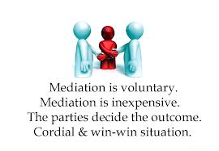
ADVANTAGES OF MEDIATION
Direct engagement in negotiating
Mediator is a neutral third party
Cost effective
Enhances the likelihood of the parties continuing their relationship during and after the proceedings
Confidentiality is maintained
Mediation is simple and flexible

Slide 40
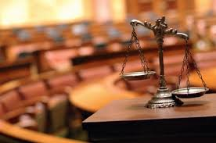
NEED FOR MEDIATION IN INDIA
Country of about 1.3billion population
Unprecedented ‘litigation explosion’
Liberalization and Globalization also have lead to litigation
About 100 million Indians waiting for justice
About 30 million cases pending in different courts

Slide 41
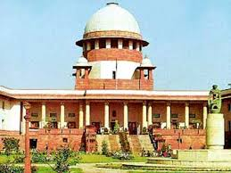
NEED FOR MEDIATION IN INDIA
The Apex Court of India pendency figures as on July 1, 2014 with 65,970 cases pending for adjudication.
It will be 2330 by the time Indian courts, working at the current pace, clear the backlog of cases that exists today.

Slide 42
EMERGENCE OF MEDIATION
In 1994-95, Supreme Court of India under the leadership of Justice A.H Ahmadi invited USA to participate in a national assessment of backlog in civil courts which led to the realisation of the formation of alternate dispute resolution in India.
The procedural reforms suggested were incorporated but lacked efficient implementation.

Slide 43
EMERGENCE OF MEDIATION
For this purpose, a Committee headed by former Judge of the Supreme Court and Chairman of the Law Commission of India, Justice M. Jagannadha Rao, was constituted.
On the basis of the Report, the Hon’ble Supreme Court of India has pronounced a landmark decision Salem Advocate Bar Association, Tamil Nadu v. Union of India (2005), where it held that reference to mediation, conciliation and arbitration are mandatory for court matters.

Slide 44
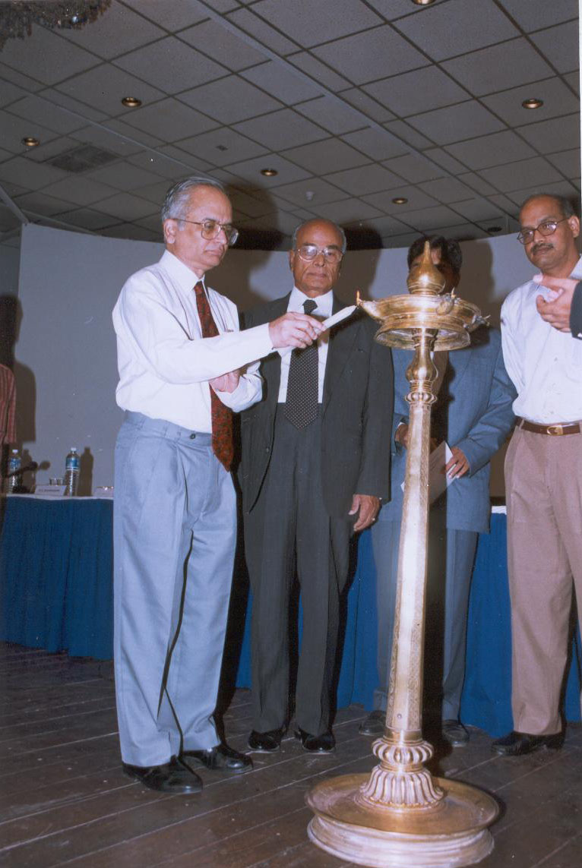
EMERGENCE (CONTD.)
The committee headed by Mr. Justice Jagannadha Rao formulated the Civil Procedure ADR Rules and Mediation Rules, 2003 for providing guidelines for conducting mediation proceedings.

Slide 45
DIFFERENCE BETWEEN CONCILIATION AND MEDIATION
Difference appears to be more on account of historical usage as conciliation was in vogue before the 1980’s.
Degree of intervention by neutral third party is more in conciliation than mediation.
But in Afcons Infra. Ltd. v. M/s Cherian Varkey Constructions (2010) the Supreme Court clarified that mediation is a synonym of conciliation.

Slide 46
STATUTORY PROVISIONS RELATING TO MEDIATION
Order X Rules 1A, 1B and 1C were introduced in 1999 and provided that the court “shall” direct the parties to opt for either modes of settlement in Section 89.
Order XXIII deals with a compromise suit and declares that such settlement will be recorded and a decree will be passed.
Order XXXIIA states that the court will assist parties to arrive at a settlement in every suit relating to family matters.
Order XXVII and XXXIIA suggest that the court will assist parties to arrive at a settlement in every suit involving dispute with the government or dispute relating to family matters respectively.

Slide 47
THE ARBITRATION AND CONCILIATION ACT, 1996
This act replaced the 1940 Act and incorporated a separate part on conciliation modeled on the lines of the UNCITRAL Conciliation Rules,1980.
Section 30 is a recognition of consensual ADR scheme as even in an arbitration the arbitrator may suggest the parties to reach a settlement.

Slide 48
THE ARBITRATION AND CONCILIATION ACT, 1996
Part III of the Act deals with conciliation which is synonymous with mediation.
Section 74 confers upon the settlement agreement the status and effect of an arbitral award which is enforceable like a decree.

Slide 49
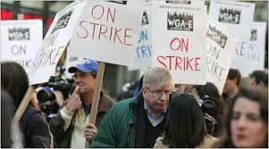
INDUSTRIAL DISPUTES ACT,1947
Provides for appointment of conciliation officers by central or state government.
Where dispute exists, conciliation proceeding may be hold to bring about a settlement.
Provides for confidentiality.

Slide 50
FAMILY LAW
The Hindu Marriage Act, 1955 and The Special Marriage Act, 1954 provide that before the proceedings for any relief the court will make endeavor to bring about reconciliation.
The Family Courts Act, 1984 in its preamble itself talks about settlement.

Slide 51
ENCOURAGEMENT OF MEDIATION IN FAMILY DISPUTES
In B.S. Krishnamurthy v. B.S. Nagaraj (2010), the Supreme Court speaking through Justice Markandey Katju emphasized the need for lawyers to advise their clients to try mediation especially where family relationships are involved.

Slide 52
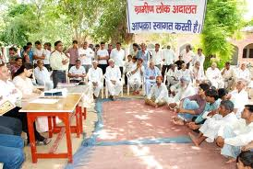
LOK ADALAT
The Legal Services Authorities Act, 1987 was brought in with the primary purpose of providing free legal services and organizing Lok Adalats for settlement of disputes.

Slide 53
CHALLENGES IN INDIAN SOCIETY
Settlement under mediation is not enforceable unless decreed by the Court.
Indian lawyers view mediation as potentially depriving them of income by settling cases prematurely.
Private litigants, too, may harbour anxiety about mediation as an alternative to the court system.

Slide 54
CHALLENGES (Cont.)
Fearful of exploitation, distrustful of private proceedings, comforted by the familiarity of the court system, insecure about making decisions about their own interests, or interested in vexatious litigation or in delaying the case for economic reasons, some litigants may prefer the lawyer-dominated, public, formal, and evaluative judicial process.

Slide 55
MEDIATION AS AN EFFECTIVE TOOL
Explosion of mediation is being spearheaded by corporations, as multi-national corporations seek quicker, cheaper and less disruptive means for settling internal employer, management and shareholder disputes and external commercial disputes with trade and distribution partners around the world.

Slide 56
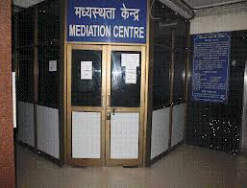
MEDIATION as an EFFECTIVE TOOL
In the few years the since mediation centres of Delhi (2005) and Bangalore (2007) have been up and running, approximately 30,969 cases have gone through the mediation process, and 60% of these cases have been settled since then. This has resulted in 18,581 cases being resolved in a matter of two months each instead of years of fighting in the court.

Slide 57
CONCLUSION
To show the advantages and essence of mediation at present it is considered that the approach of courts sending parties for mandatory mediation may inspire confidence as India is high context society where cultural norms and customs play a vital role in bringing a solution to any dispute and thus only once the parties are send for such mediation they realize its efficacy and uniqueness.

Slide 58
CONCLUSION (Contd.)
Finally it would be apt to say that Mediation can only be achieved if we understand that this fast paced process of ADR is not an independent procedure but procedure that is connected with the judicial system and that compliments and does not supplant the justice system as a whole. In achieving this level of understanding the litigants must put their faith in court annexed mediation which is a vital element in development and evolution of Mediation as Dispute Resolution system preferred than other systems prevalent in the legal framework.

Slide 59
THANK YOU
-SHASHANK GARG

